Slide 1
Chinese word segmentation
Wendy Liu

Slide 2
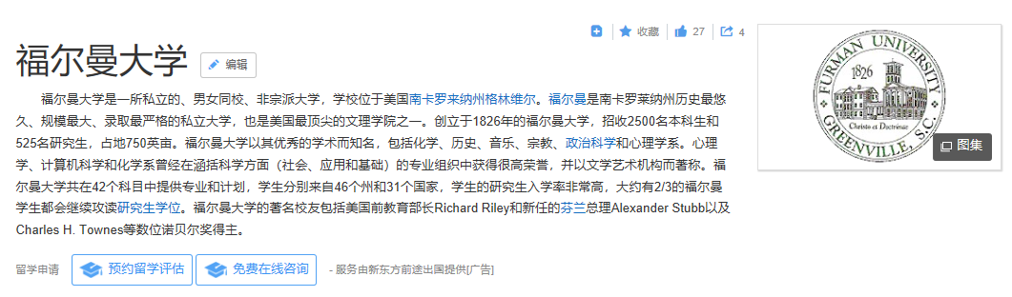
A typical Chinese paragraph

Slide 3
3 types of Chinese word segmentation algorithms
By semantic meanings
Dictionary-dependent algorithms
Statistic-based algorithms (machine learning algorithms)

Slide 4













Dictionary-dependent algorithms
Forward procedure
“Furman University has a bell tower.”
Result：

Slide 5
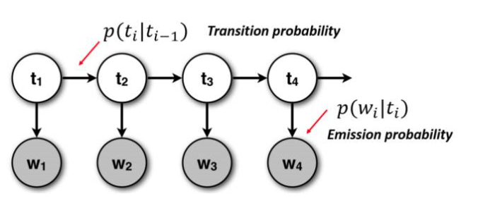


Machine learning algorithms
Hidden Markov Model (HMM)
Based on Bayesian model
Uses Viterbi algorithm
Use probabilities
E.g. “Older students” vs. “college students”

Slide 6
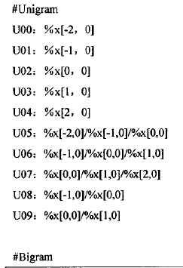

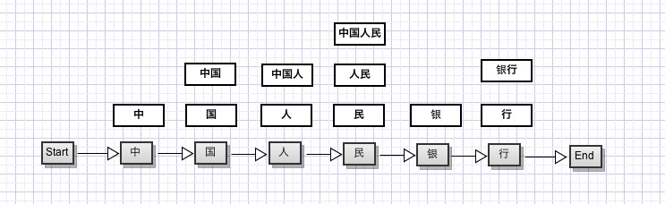
Machine learning algorithms
Conditional random field (CRF)
Calculates probabilities and considers correlations between different words according to their meanings
Also based on Viterbi algorithm
“the People’s Bank of China”

